Slide 1
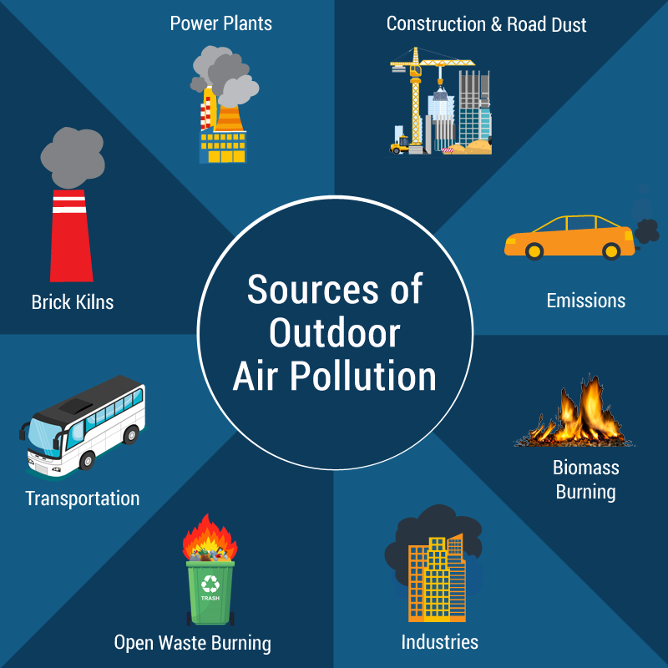
AIR QUALITY PREDICTION SYSTEM
VANSHIKA MITTAL
2019218
SEC F RN- 74

Slide 2
INTRODUCTION
Air quality prediction plays a pivotal role in safeguarding public health and environmental sustainability. With increasing concerns about pollution, accurate forecasting of air quality levels has become imperative. Leveraging advanced machine learning algorithms, this study aims to predict air quality indices based on key environmental parameters. By analyzing historical data and employing models such as Logistic Regression, Decision Trees, Random Forests, and K-Nearest Neighbours, our research seeks to provide a reliable framework for anticipating air quality conditions. This predictive approach not only aids in proactive pollution management but also contributes to informed decision-making for mitigating the adverse impacts of air pollution on communities and ecosystems.

Slide 3
PROBLEM STATEMENT
Develop a predictive model for air pollution levels in various regions based on historical air quality data. The goal is to create a system that can accurately forecast the concentration of key air pollutants such as sulfur dioxide (SO2), nitrogen dioxide (NO2), respirable suspended particulate matter (RSPM), and suspended particulate matter (SPM). The prediction model should take into account various environmental factors and provide insights into the potential air quality index (AQI) values.

Slide 4
WHY IS IT IMPORTANT?
An air quality prediction model is crucial for public health and environmental management. By forecasting air quality levels, it enables proactive measures to mitigate the adverse effects of pollution. Such models empower communities and policymakers to make informed decisions, implement preventive strategies, and allocate resources efficiently. As air pollution increasingly impacts global well-being, a reliable prediction model serves as an early warning system, safeguarding vulnerable populations from respiratory illnesses and contributing to sustainable environmental practices. Ultimately, these models play a pivotal role in fostering healthier living conditions and promoting the long-term well-being of both individuals and the planet.

Slide 5
METHODOLOGY
1. Data Understanding:
- Acquire historical air quality data, including SO2, NO2, RSPM, and SPM concentrations.
2. Data Visualization:
- Utilize graphs and visualizations to analyze the distribution and trends of air pollutant levels and patterns in the data.
3. Handling Null Values:
- Identify and address null values through appropriate techniques, such as imputation or removal.
4. Calculating SO2 AQI:
- Apply the prescribed formula to calculate the Air Quality Index (AQI) for sulfur dioxide (SO2).
5. Individual Pollutant Index:
- Calculate individual pollutant indices for SO2, NO2, RSPM, and SPM using respective formulas.

Slide 6
METHODOLOGY
6. Overall AQI Calculation:
- Derive the overall Air Quality Index (AQI) for each data point, integrating individual pollutant indices.
7. Data Splitting:
- Segregate the dataset into dependent (AQI) and independent columns for model training.
8. Regression Models:
- Employ Linear Regression, Decision Tree Regressor, and Random Forest Regressor to predict pollutant concentrations.
9. Classification Models:
- Utilize Classification algorithms (Logistic Regression, Decision Tree Classifier, Random Forest Classifier, K-Nearest Neighbours) for predicting AQI categories.

Slide 7
METHODOLOGY
10. Model Evaluation:
- Assess the performance of regression and classification models using appropriate metrics.
11. Insights and Recommendations:
- Extract insights from model results to understand the impact of environmental factors on air quality.
- Provide recommendations for improving air quality based on model findings.

Slide 8
RESULT
Logistic Regression:
- Accuracy: Train - 72.76%, Test - 72.71% and Kappa Score: 0.58
- Example Predictions:
- [727, 327.55, 78.2, 100] → 'Good’ - [2.7, 45, 35.16, 23] → 'Poor'
Decision Tree Classifier:
- Accuracy: Train - 100%, Test - 99.98%
- Kappa Score: 0.9997
- The model exhibits potential overfitting, given the perfect accuracy on the training set.

Slide 9
RESULT
Random Forest Classifier:
- Accuracy: Train - 100%, Test - 99.99% and Kappa Score:0.9998
- Similar to the Decision Tree, the Random Forest model demonstrates high accuracy but may be overfitting.
K-Nearest Neighbours (KNN):
- Accuracy: Train - 99.81%, Test - 99.67%
- Kappa Score:0.9951
- Example Predictions:
- [7.4, 47.7, 78.182, 100] → 'Poor’ , [1, 1.2, 3.12, 0] → 'Good’ , [325.7, 345, 798.182, 203] → 'Unhealthy'

Slide 10
CONCLUSION
- The Decision Tree and Random Forest models demonstrate exceptional accuracy but raise concerns about potential overfitting.
- Logistic Regression provides moderate accuracy and interpretable results.
- K-Nearest Neighbours performs well with high accuracy and reasonable Kappa Score.
- Consider model selection based on the balance between accuracy, interpretability, and generalization.
- Further model tuning and exploration of alternative algorithms could enhance overall performance.
- The models can effectively predict air quality categories based on the given features, providing valuable insights for environmental monitoring and management.

Slide 11

VANSHIKA MITTAL 2019218 ROLL NO 74 SEC - F

